Slide 1

Introduction to Document
બેઝિક Document
CSR Initiative of Tata Power & Sai’s Angel Foundation, Vadodara

Slide 2
Basic Typing

Slide 3
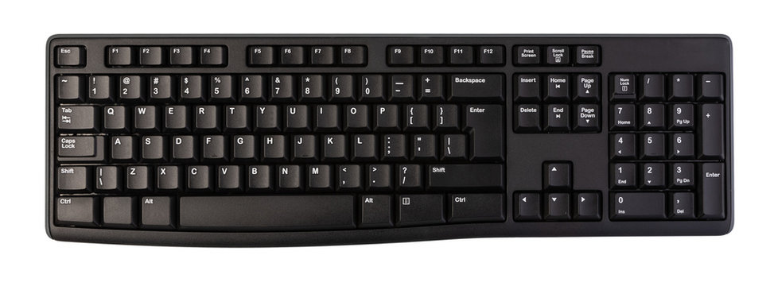

Slide 4
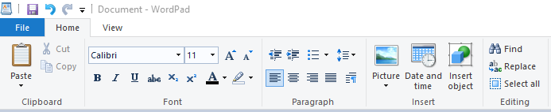
Home Menu in Wordpad

Slide 5
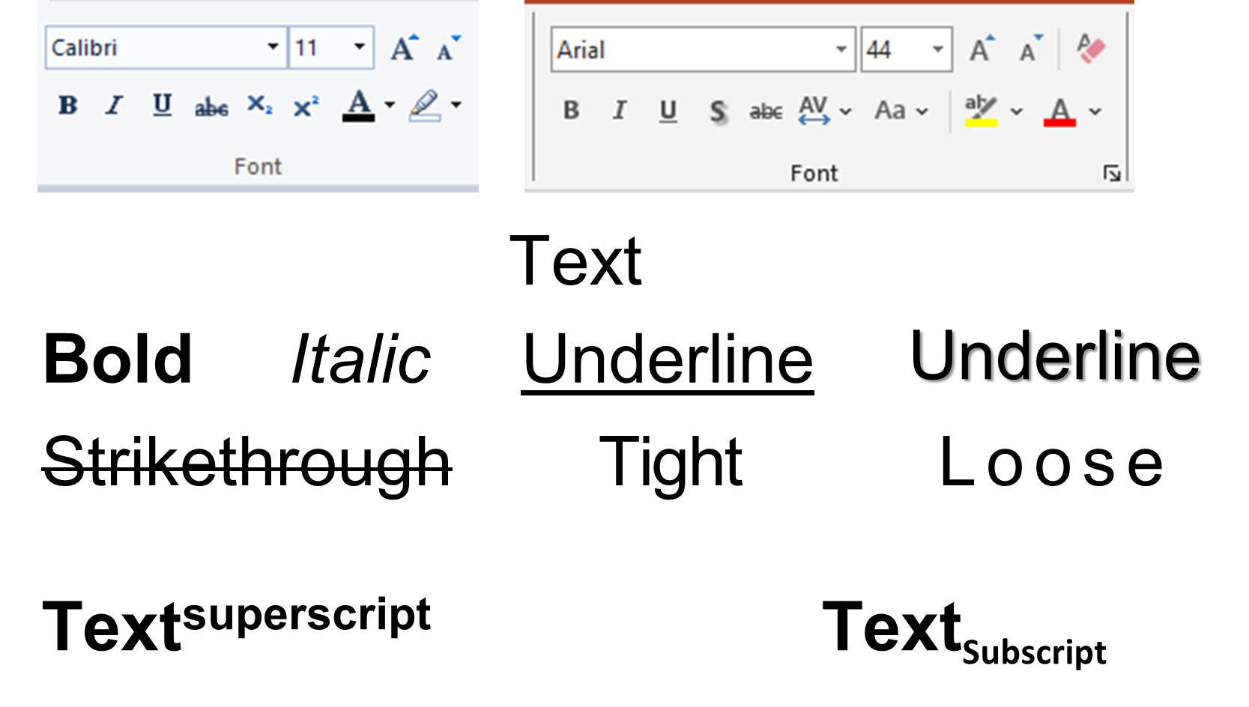

Slide 6
Typing Practice
My name is Raj I am studying in 8th standard leaving near Mandvi which is located in Kutch district my village name is gundiali
I will be learning about basic computer in digital literacy program by Sai Angel Foundation and it is being supported by a CSR University of Tata Power I am very thankful to search initiated I always had a dream to learn about computer

Slide 7
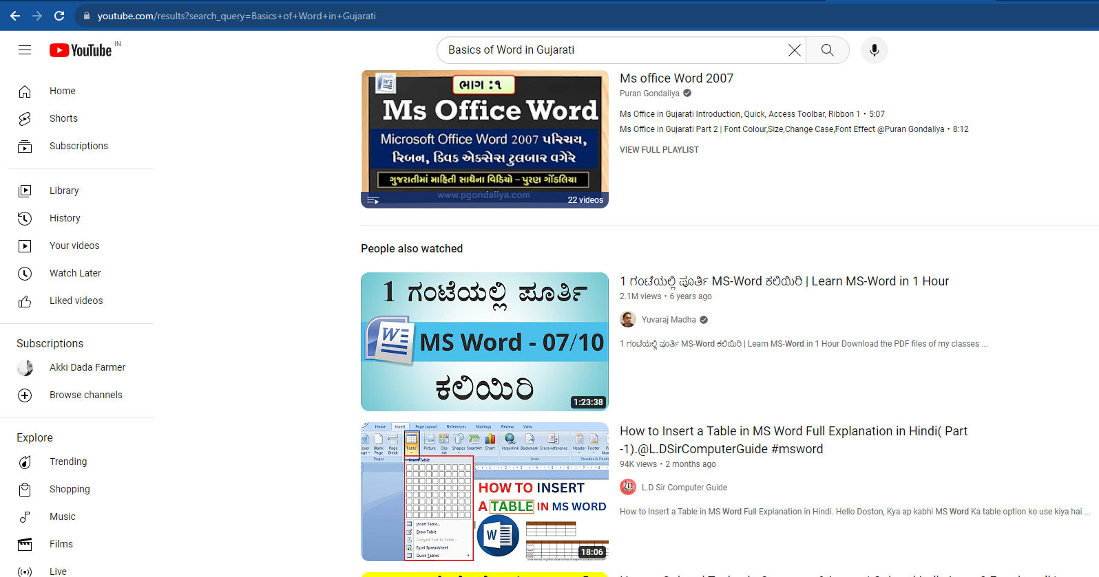

Slide 8
Keywords to Learn about Document
Basics of Word in Gujarati
Basics of Text formatting in Word Gujarati
Basics of printing and pagesetup

Slide 9

બેઝિક સર્કિટ એક્ટિવિટીમાં કોઈ જગ્યાએ કંઈ ન સમજાયું હોય
હાથ ઉપર કરો અને પૂછો
Notes:
હાથ ઉપર કરો અને પૂછો

